Slide 1
Data Intelligence Application
Multi Armed Bandit for Dynamic pricing of public parkings
Dello Preite Castro Gianmarco - matricola 905131
Paci Marco - matricola 905713
Valladares Stefano - matricola 893624

Slide 2
INTRODUCTION
1

Slide 3
Problem contextualization
BASIC SETTINGS
For every driver that arrives at the parking:
The driver arrives at the entrance of the parking willing to park its car;
The system chooses a price per hour based on a specific policy and shows it to the driver;
The driver can decide to accept the price and park the car or refuse it and go away;
The system records the driver’s response and updates its beliefs about what is the true optimal price of that parking by following a specific policy.
FURTHER INFORMATION
Each parking has a location that characterizes the optimal price per hour.
The period of the year also affects the optimal price.

Slide 4
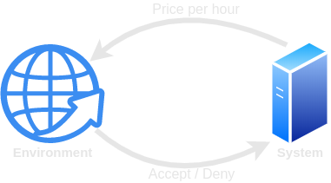
OFFLINE SIMULATION
Real world
The set of drivers and their responses represent the environment.
Simulation
Each driver is modeled as a Bernoulli variable having as mean the true mean.

Slide 5
ALGORITHM ADAPTATION
Arm: Each arm has assigned a price and it estimates the reward for selling a park lot with that price per hour.
Problem: Given a set of prices (arms) find the price per hour for selling a park lot that maximizes the reward obtained.
Solution: The best price among the set of prices
Hyperparameters
Number of prices (arms)
Time horizon
Sliding window length for the non stationary case
Number of repetitions for deleting noise due to the simulation of the environment.

Slide 6
ASSUMPTIONS
Parkings lots are infinite.
We consider only the case of a monopoly scenario.
The cost for selling a parking lot is constant and equal to zero.
In the non stationary case the pricing distributions are subject to abrupt changes, they are four during the year and they are fixed, i.e. the demand curve in each phase can be considered stationary.
The contexts are not correlated with each other.
People is willing to pay different prices depending on the zone where the parking is located.

Slide 7
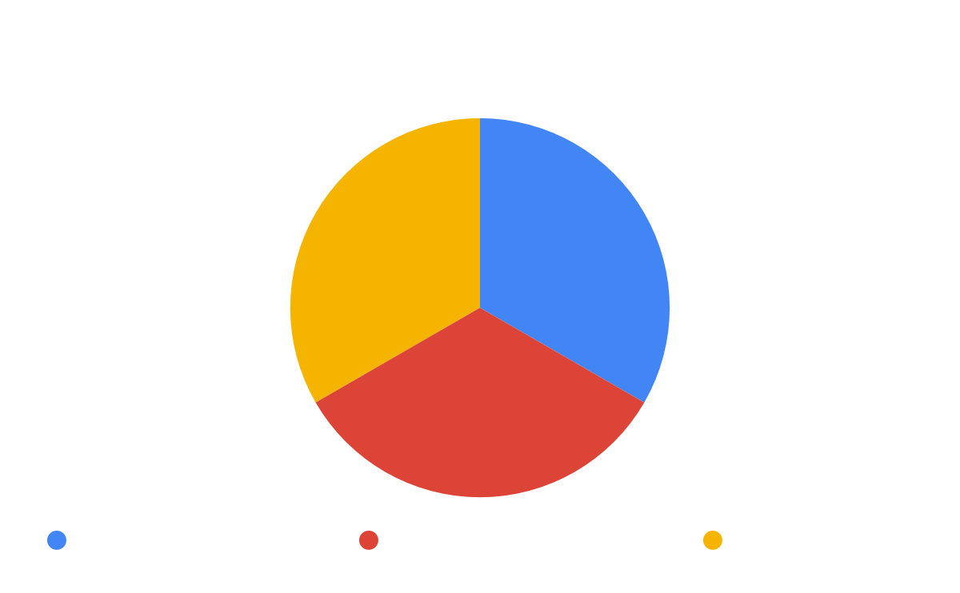

Contexts and Phases
Phases
Spring | Summer
Winter | Autumn

Slide 8
POLICIES
2

Slide 9
Exploration Exploitation dilemma
AB-Testing
First explore for n rounds, then exploit what you have learned. Only offline.
Multi-Armed Bandit
At every round select the prize (pull the arm) that maximizes the reward obtained.
Non stationary MAB
The decision of the best price at each round is based on only the last k observations.
Contextual MAB
The decision of the best price at each round is based also on the location of the parking where the price has to be selected.

Slide 10
AB Testing vs Bandits
AB Testing
Offline
Compare arms two at the time using n samples.
Select each time the best arm if the difference is statistically significant using the Z-Test.
At the end the policy knows the true mean of the reward of each arm with big confidence.
Bandits
Online
Compares all arms at the time.
Select each time the arm who maximizes an objective function.
At the end the algorithm will know the true mean of the reward of only the best arms.

Slide 11
UCB1 vs TS
Upper Confidence Bound
At every round, choose as optimal price the one that maximizes the upper confidence bound of the set of prices selected in the optimization.
Thompson Sampling
At every round, sample from a prior Beta distribution over the prices and select the price with the maximum sample.
Greedy
At every round, select the price with the higher estimated reward.

Slide 12
Non stationary strategy
Problem
The demand curve of parking lots changes during the year
Strategy
The policy uses a sliding window mechanism and, at each round, it considers only the observations in the window for deciding the next price to offer.
If the windows contains enough sample to make the policy learn the curve at each phase, the policy is capable of following the changing in the pricing distribution.

Slide 13
Contextual strategy
Problem
The demand curve of parking lots is affected by the location of the parking.
Strategy
The policy uses one different policy for each parking and one for the aggregate case. Then, at each round it decides what policy to follow basing on the actual context and the total gain in switching from the aggregate policy to the set of disaggregate ones.

Slide 14
EXPERIMENTS
3

Slide 15
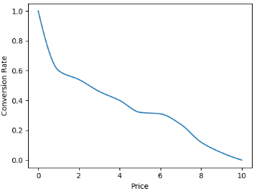
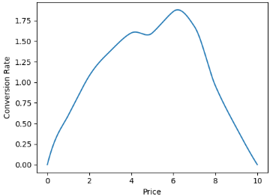
Input data
Demand curve: for each price per hour x, it represents the percentage of people that will accept that price.
Reward curve: for each price per hour x, it represents the reward that we will obtain by selling the park lot at that price.
Reward = conversion rate x price
Demand curve
Reward curve

Slide 16
The following curves are examples of what we think they would be the demand curves in three parkings of Milan, depending on the zone and on the period of the year.

Slide 17
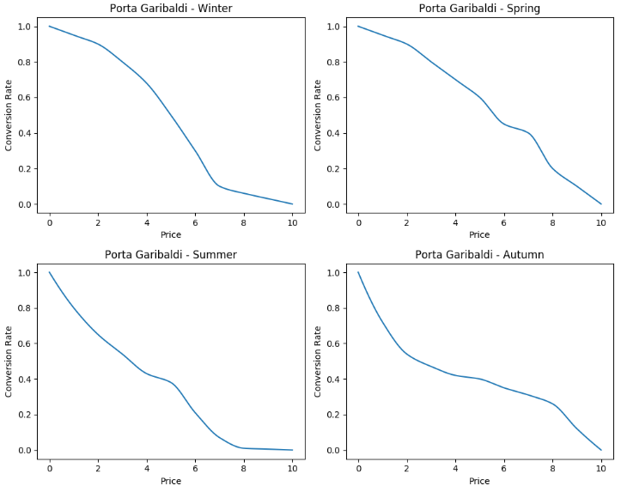
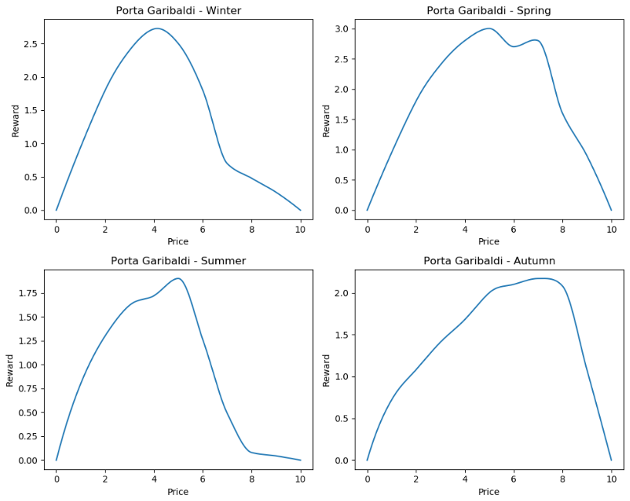
Porta Garibaldi

Slide 18
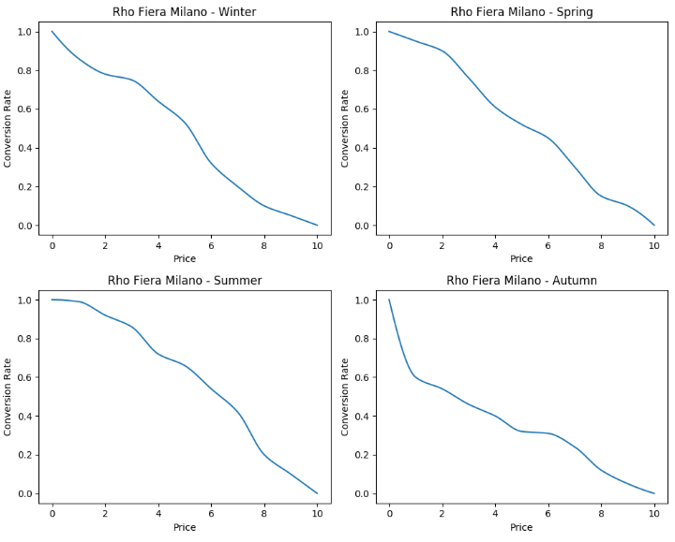
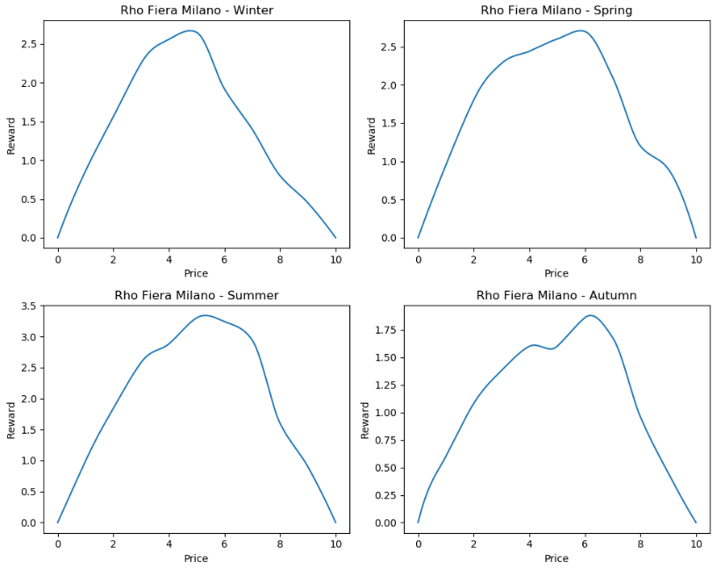
Rho Fiera Milano

Slide 19
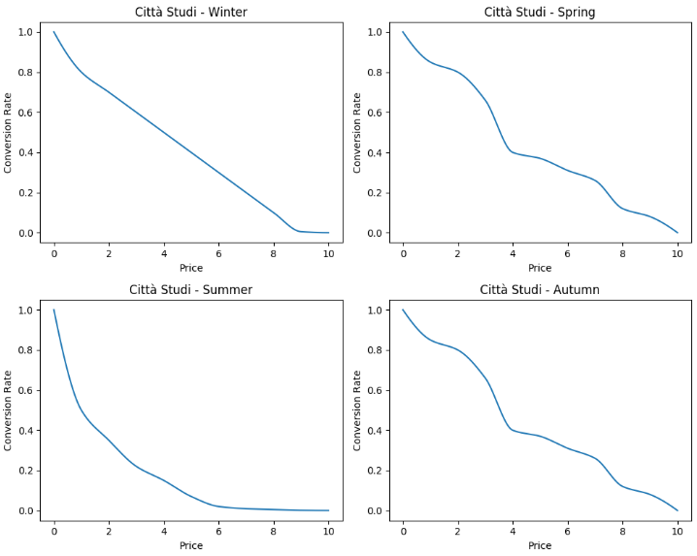
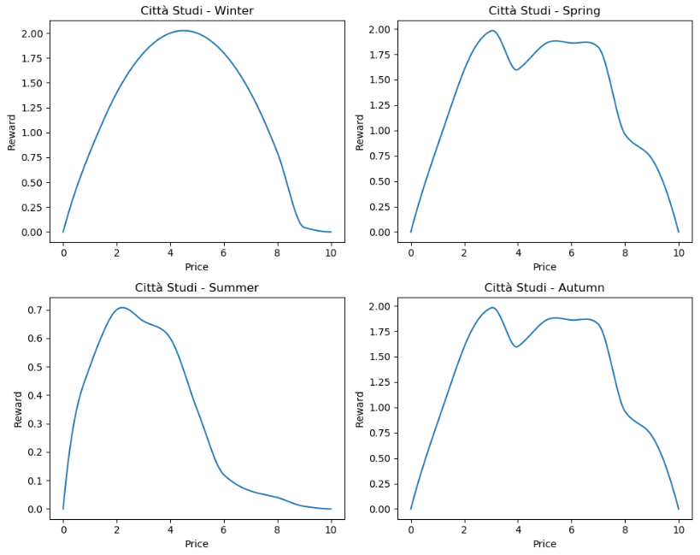
Città Studi

Slide 20
RESULTS
4

Slide 21
EXPERIMENTAL SETUP
 | Stationary | Non Stationary | Contextual
Time horizon | 3000 samples | 6000 samples | 6000 samples
Sliding Window |  | 1500 samples
Number of Arms | 8 | 8 | 8
Exploration parameter for the UCB1 policy (c) is set to 2.
Comparison metrics: Reward and Regret
Note:
200 customer per day x 15 days = 3000 samples
In the real case, we can use much more samples for the sliding window.
For the contextual and non stationary case we only run 100 repetitions, that is not enough for eliminating all the noise, but it lets us run the algorithms in an acceptable time.
In the experiments with less curves, they are taken from the Rho Fiera Milano curves.

Slide 22
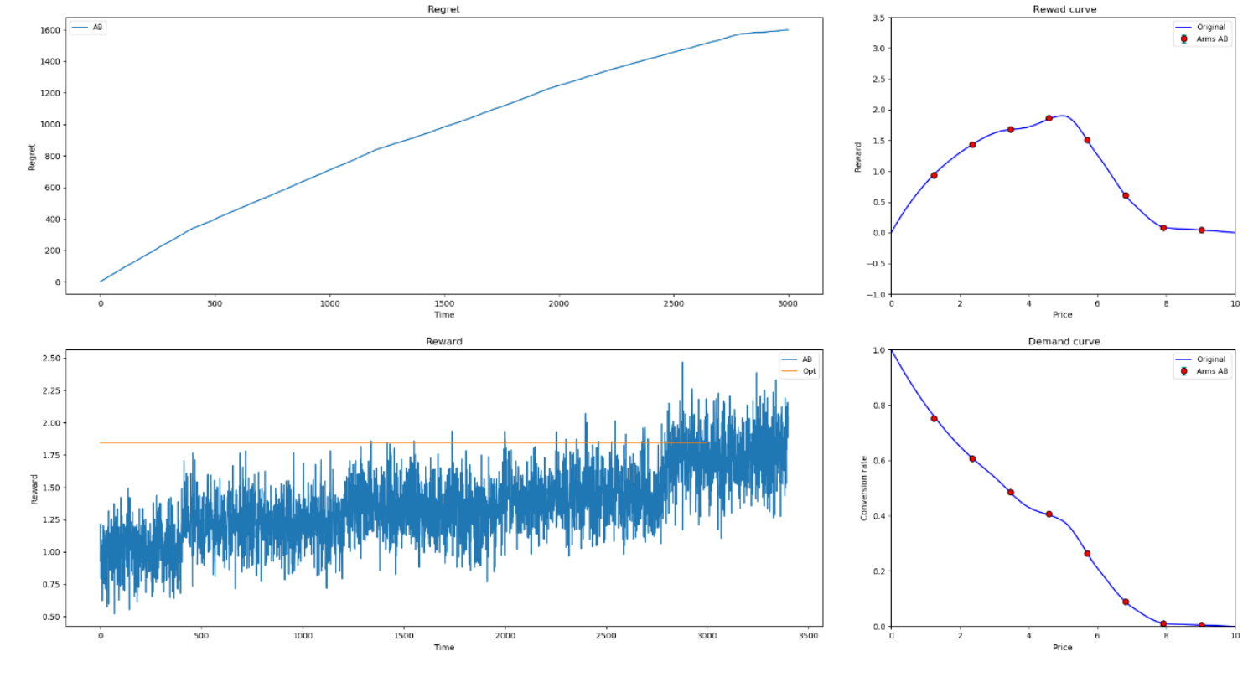
AB Testing

Slide 23
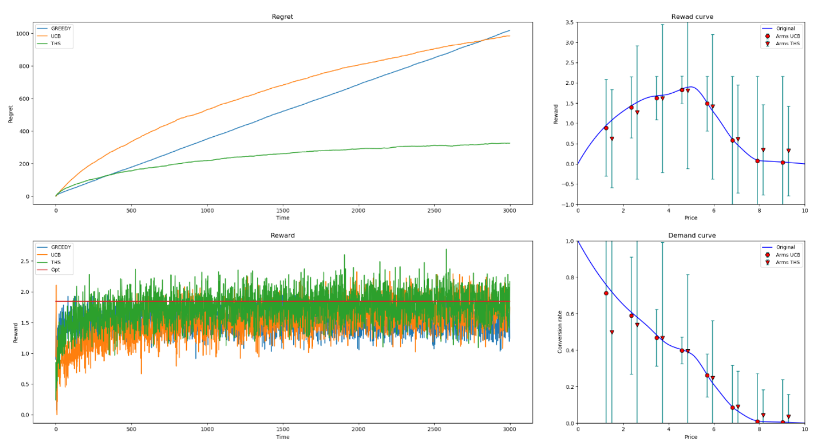
Stationary case

Slide 24
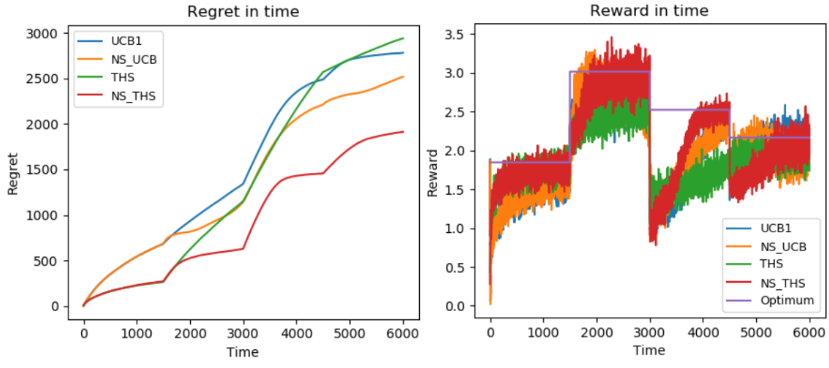
Non Stationary case

Slide 25
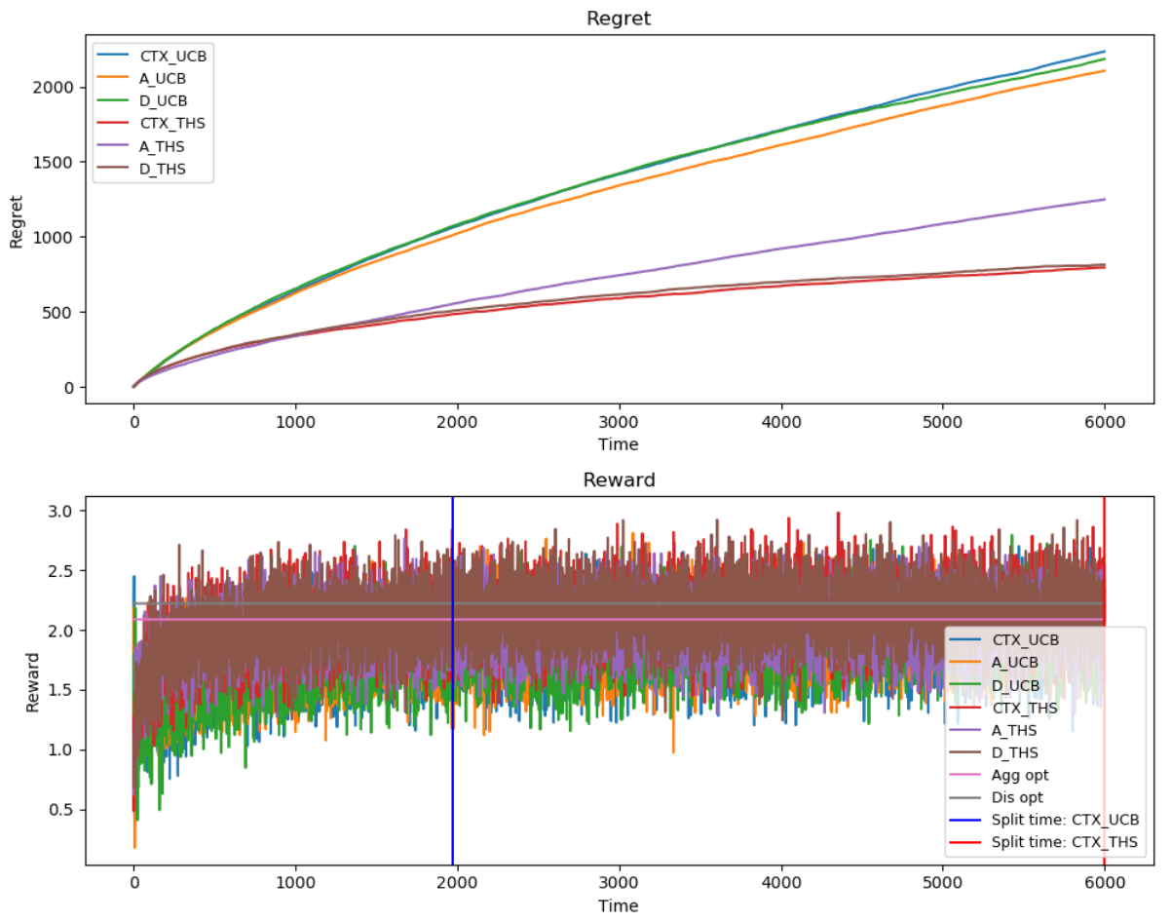
Contextual Stationary case

Slide 26
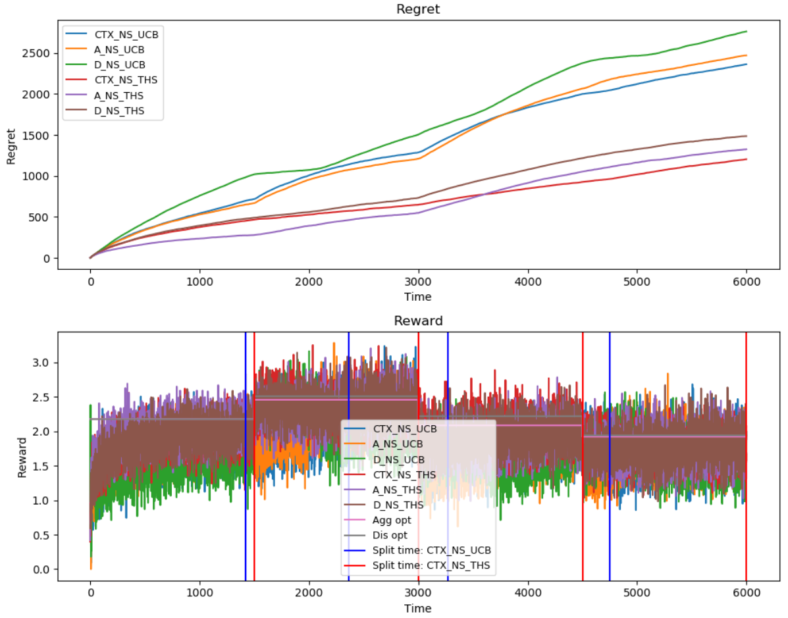
Contextual Non Stationary case

Slide 27
CONCLUSION
5

Slide 28
The Bandit framework is easily adaptable for optimize the price of parking lots per hour of a private parkings.
The Thompson Sampling algorithm outperforms all the others in all the cases.
We suggest to repeat the experiments, before applying the algorithms in a real case with an higher time horizon number of repetitions, in order to better analyze the contextual non stationary case, as in our case we had to trade-off the reliability of the results with a reasonable running time for testing the algorithms, due to our limit of computational power.

Slide 29
THANKS FOR THE ATTENTION

